Slide 1
Kitty Cat Space Map Mockup
Group 16

Slide 2
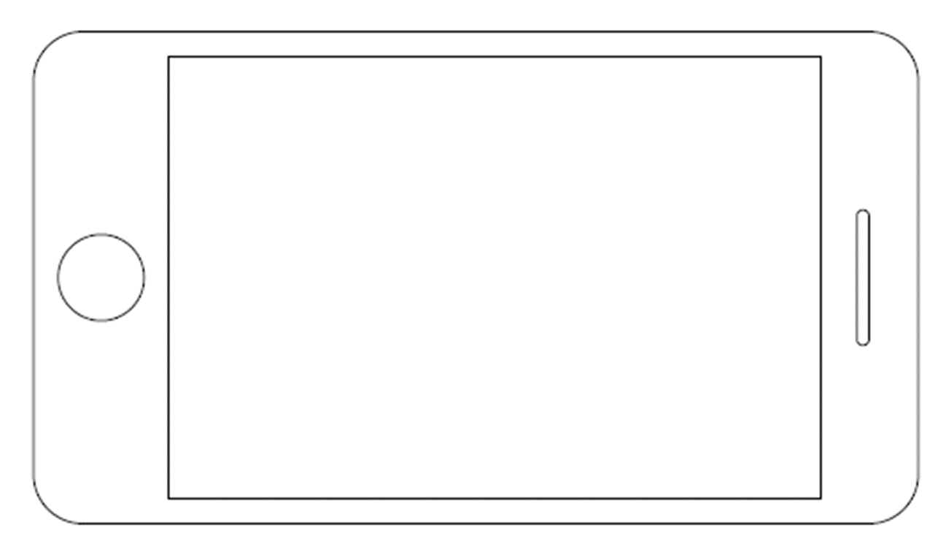

Main Menu

Slide 3
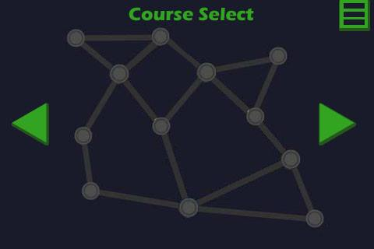
World Select

Slide 4
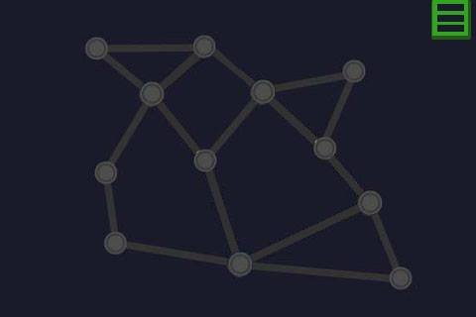
Loading

Slide 5
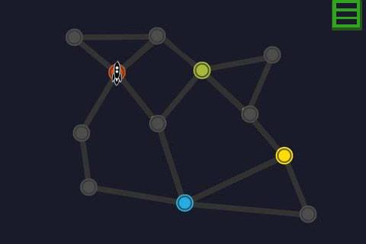
Loading

Slide 6

Loading

Slide 7
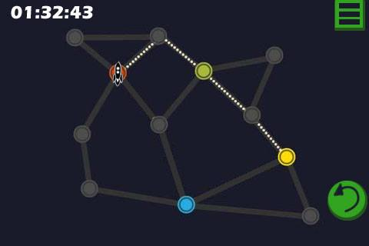
Gameplay

Slide 8
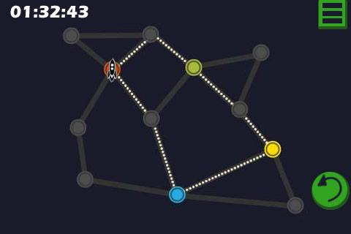
Gameplay

Slide 9
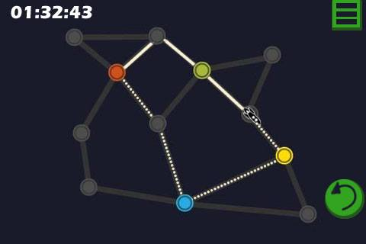
Gameplay

Slide 10
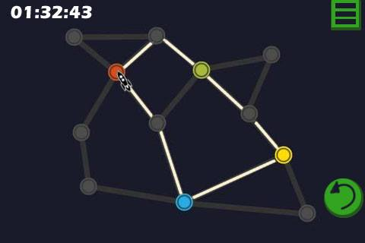
More Gameplay

Slide 11
Flowchart

Slide 12
Questions?

